Slide 1

LGB Robotic Automation Projects

Slide 2
PROJECT OVERVIEW
S.No | Project | Process Scope | Robots / Cobots | Start Date | End Date | Current Status
1 | Stellantis line 1-Phase | OP10 , Ultrasonic washing , Vision , OilWashing | 2 × UR12e Cobots | 07-07-2025 | 20-07-2026 | Installation & inprogress
2 | BMW RAD Line | OP10 → OP20→OP30→OP40 | 4 Cobots + 1 AMR | 02-02-2026 | 20-09-2026 | DAP approved
3 | Helical Line | OP10 → OP20 | 2 UR12e Cobot + 1 yaskava 20kg robot | 31-03-2026 | 20-09-2026 | 2 Cobot cell installation & commissionong inprogress
4 | Ather Line | OP10 → OP20 | 5 × ABB 12kg Cobots | 15-02-2026 | 15-10-2026 | Mechanical & electrical iteam are under manafacturing
5 | Daimler Line | OP10 → OP20 | 4 × UR12e Cobots | 24-04-2026 | 15-10-2026 | One cell productiion trail inprogress
LGB l Operations Technology

Slide 3
01
Stellantis Line

Slide 4
STELLANTIS LINE - PHASE 1
LGB l Operations Technology

Slide 5
STELLANTIS LINE - PHASE 1 ( SEP plan vs actual )
LGB l Operations Technology

Slide 6
STELLANTIS LINE - PHASE 1 OCTUMBER PLANNED TASK
LGB l Operations Technology

Slide 7
02
Helical Machine Tending Line

Slide 8
Helical line - SEPTEMBERT (PLAN VS ACTUAL )
HELICAL LINE
Task ID | Task Description | Team | Planned |  | Actual |  | Status | % Complete | Remarks
 |  |  | Start Date | End Date | Start Date | End Date
AT-T37 | FAT | Project | 5-Sep-26 | 6-Sep-26 | 6-Sep-26 | 7-Sep-26 | Close | 100%
AT-T38 | Dispatch | Robonetics | 7-Sep-26 | 8-Sep-26 | 8-Sep-26 | 9-Sep-26 | Close | 100%
INSTALLATION & COMMISSIONING IN TWO COBOT CELL
AT-T39 | Material Receipt at Customer Site | LGB + Robonetics | 10-Sep-26 | 11-Sep-26 | 17-Sep-26 | 18-Sep-26 | Close | 100%
AT-T40 | Unloading & Inspection | LGB + Robonetics | 12-Sep-26 | 13-Sep-26 | 19-Sep-26 | 20-Sep-26 | Close | 100%
AT-T41 | Machine Positioning & Alignment | LGB | 3-Sep-26 | 4-Sep-26 | 3-Sep-26 | 4-Sep-26 | Close | 100%
AT-T42 | Input table & Output table Leveling & Assemble | Robonetics | 14-Sep-26 | 15-Sep-26 | 16-Sep-26 | 17-Sep-26 | Close | 100%
AT-T43 | Cobot Pedestal Installation | Robonetics | 16-Sep-26 | 17-Sep-26 | 17-Sep-26 | 19-Sep-26 | Close | 100%
AT-T44 | Cobot Installation | Robonetics | 16-Sep-26 | 17-Sep-26 | 17-Sep-26 | 19-Sep-26 | Close | 100%
AT-T45 | Gripper Installation | Robonetics | 19-Sep-26 | 20-Sep-26 |  |  | Open
AT-T46 | Pneumatic Line Installation | Robonetics | 21-Sep-26 | 22-Sep-26 |  |  | Open
AT-T47 | Control Panel Installation | Robonetics | 16-Sep-26 | 17-Sep-26 |  |  | Open
AT-T48 | Electrical Wiring & Cable Dressing | Robonetics | 25-Sep-26 | 26-Sep-26 |  |  | Open
AT-T49 | PLC, HMI & Network Connections | Robonetics | 27-Sep-26 | 28-Sep-26 |  |  | Open
AT-T50 | Power ON & I/O Verification | Robonetics | 28-Sep-26 | 29-Sep-26 |  |  | Open
LGB l Operations Technology

Slide 9
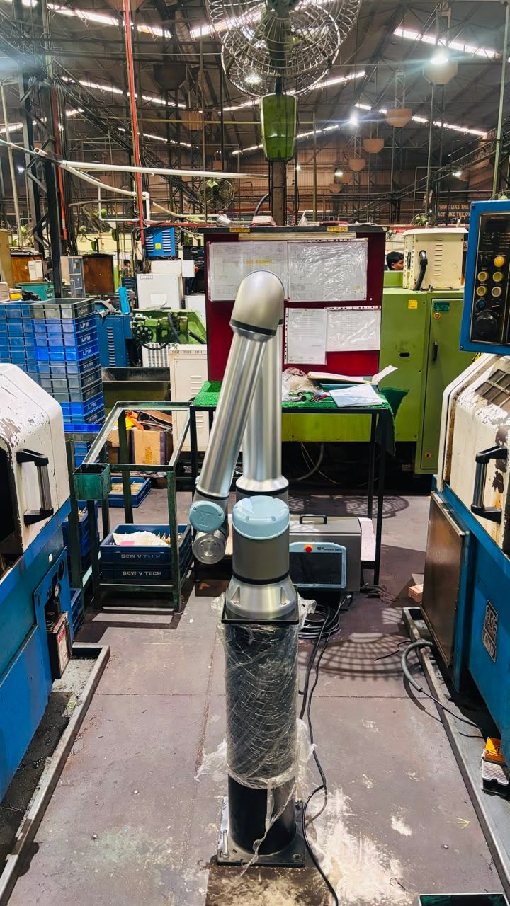
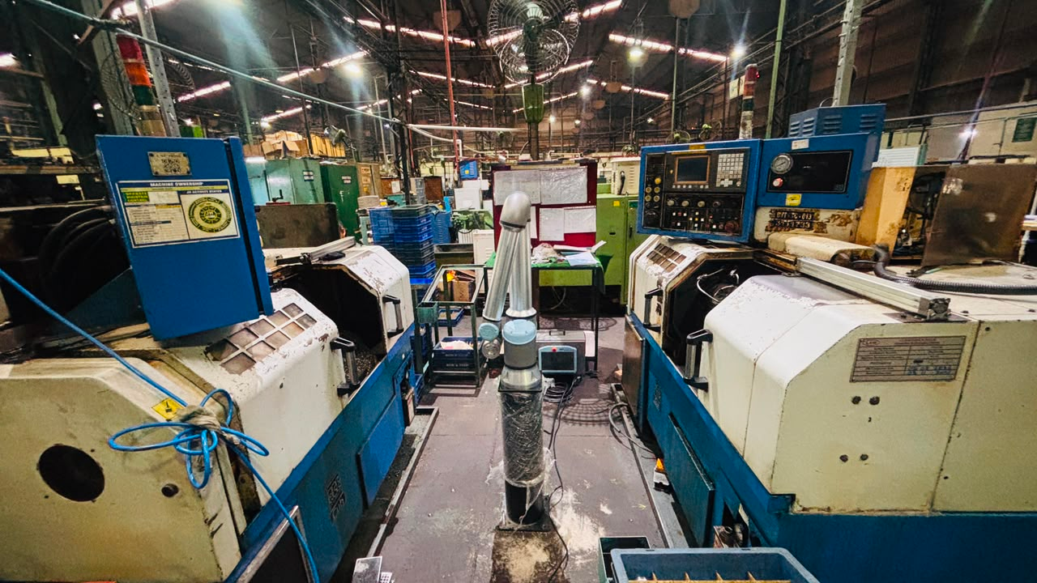
Helical line - SEP - Plan VS Actual
COBOT CELL ASSEMBLED AS PER THE AUTOMATION LAYOUT
LGB l Operations Technology

Slide 10
Helical line - OCTOBER PLANNED TASK
HELICAL LINE
Task ID | Task Description | Team | Planned |  | Actual |  | Status | % Complete | Remarks
 |  |  | Start Date | End Date | Start Date | End Date
AT-T37 | FAT | Project | 5-Sep-26 | 6-Sep-26 | 6-Sep-26 | 7-Sep-26 | Close | 100%
AT-T38 | Dispatch | Robonetics | 7-Sep-26 | 8-Sep-26 | 8-Sep-26 | 9-Sep-26 | Close | 100%
INSTALLATION & COMMISSIONING IN TWO COBOT CELL
AT-T39 | Material Receipt at Customer Site | LGB + Robonetics | 10-Sep-26 | 11-Sep-26 | 17-Sep-26 | 18-Sep-26 | Close | 100%
AT-T40 | Unloading & Inspection | LGB + Robonetics | 12-Sep-26 | 13-Sep-26 | 19-Sep-26 | 20-Sep-26 | Close | 100%
AT-T41 | Machine Positioning & Alignment | LGB | 3-Sep-26 | 4-Sep-26 | 3-Sep-26 | 4-Sep-26 | Close | 100%
AT-T42 | Input table & Output table Leveling & Assemble | Robonetics | 14-Sep-26 | 15-Sep-26 | 16-Sep-26 | 17-Sep-26 | Close | 100%
AT-T43 | Cobot Pedestal Installation | Robonetics | 16-Sep-26 | 17-Sep-26 | 17-Sep-26 | 19-Sep-26 | Close | 100%
AT-T44 | Cobot Installation | Robonetics | 16-Sep-26 | 17-Sep-26 | 17-Sep-26 | 19-Sep-26 | Close | 100%
AT-T45 | Gripper Installation | Robonetics | 19-Sep-26 | 20-Sep-26 |  |  | Open
AT-T46 | Pneumatic Line Installation | Robonetics | 21-Sep-26 | 22-Sep-26 |  |  | Open
AT-T47 | Control Panel Installation | Robonetics | 16-Sep-26 | 17-Sep-26 |  |  | Open
AT-T48 | Electrical Wiring & Cable Dressing | Robonetics | 25-Sep-26 | 26-Sep-26 |  |  | Open
AT-T49 | PLC, HMI & Network Connections | Robonetics | 27-Sep-26 | 28-Sep-26 |  |  | Open
AT-T50 | Power ON & I/O Verification | Robonetics | 28-Sep-26 | 29-Sep-26 |  |  | Open
AT-T51 | Robot Calibration | Robonetics | 30-Sep-26 | 1-Oct-26 |  |  | Open
AT-T52 | PLC & Robot Program | Robonetics | 2-Oct-26 | 5-Oct-26 |  |  | Open
AT-T53 | Dry Run Trial | Robonetics | 6-Oct-26 | 7-Oct-26 |  |  | Open
AT-T54 | Production Trial | Robonetics | 8-Oct-26 | 12-Oct-26 |  |  | Open
AT-T55 | Cycle Time Optimization | Robonetics | 13-Oct-26 | 14-Oct-26 |  |  | Open
AT-T56 | Safety Validation | LGB + Robonetics | 15-Oct-26 | 17-Oct-26 |  |  | Open
AT-T57 | Operator & Maintenance Training | LGB + Robonetics | 19-Oct-26 | 22-Oct-26 |  |  | Open
AT-T58 | Site Acceptance Test (SAT) & Handover | LGB | 25-Oct-26 | 27-Oct-26 |  |  | Open
LGB l Operations Technology

Slide 11
03
Daimler line Machine Tending

Slide 12
DAIMLER LINE - SEPTEMBER ( PLAN VS ACTUAL )
Daimler line
Task ID | Task Description | Team | Planned |  | Actual |  | Status | % Complete | Remarks
 |  |  | Start Date | End Date | Start Date | End Date
AT-T37 | FAT | Project | 23-Aug-26 | 25-Aug-26 | 23-Aug-26 | 25-Aug-26 | Close | 100%
AT-T38 | Dispatch | MVGL | 25-Aug-26 | 27-Aug-26 | 25-Aug-26 | 27-Aug-26 | Close | 100%
INSTALLATION & COMMISSIONING ONE CELL (1361 PART )
AT-T39 | Material Receipt at Customer Site | LGB + MVGL | 27-Aug-26 | 28-Aug-26 | 27-Aug-26 | 28-Aug-26 | Close | 100%
AT-T40 | Unloading & Inspection | LGB + MVGL | 28-Aug-26 | 29-Aug-26 | 28-Aug-26 | 29-Aug-26 | Close | 100%
AT-T41 | Machine Positioning & Alignment | LGB | 26-Aug-26 | 27-Aug-26 | 26-Aug-26 | 3-Sep-26 | Close | 100% | 1 Week dely due to machine movement
AT-T42 | Input table & Output table Leveling & Assemble | MVGL | 28-Aug-26 | 29-Aug-26 | 5-Sep-26 | 6-Sep-26 | Close | 100%
AT-T43 | Cobot Pedestal Installation | MVGL | 30-Aug-26 | 31-Aug-26 | 4-Sep-26 | 6-Sep-26 | Close | 100%
AT-T44 | Cobot Installation | MVGL | 31-Aug-26 | 1-Sep-26 | 6-Sep-26 | 7-Sep-26 | Close | 100%
AT-T45 | Gripper Installation | MVGL | 2-Sep-26 | 3-Sep-26 | 7-Sep-26 | 8-Sep-26 | Close | 100%
AT-T46 | Pneumatic Line Installation | MVGL | 4-Sep-26 | 5-Sep-26 | 8-Sep-26 | 9-Sep-26 | Close | 100%
AT-T47 | Control Panel Installation | MVGL | 2-Sep-26 | 4-Sep-26 | 4-Sep-26 | 7-Sep-26 | Close | 100%
AT-T48 | Electrical Wiring & Cable Dressing | MVGL | 6-Sep-26 | 7-Sep-26 | 10-Sep-26 | 12-Sep-26 | Close | 100%
AT-T49 | PLC, HMI & Network Connections | MVGL | 8-Sep-26 | 9-Sep-26 | 13-Sep-26 | 14-Sep-26 | Close | 100%
AT-T50 | Power ON & I/O Verification | MVGL | 10-Sep-26 | 11-Sep-26 | 15-Sep-26 | 18-Sep-26 | Close | 100%
AT-T51 | Robot Calibration | MVGL | 8-Sep-26 | 9-Sep-26 | 13-Sep-26 | 14-Sep-26 | Close | 100%
AT-T52 | PLC & Robot Program | MVGL | 10-Sep-26 | 15-Sep-26 | 14-Sep-26 | 18-Sep-26 | Close | 100%
AT-T53 | Dry Run Trial | MVGL | 15-Sep-26 | 16-Sep-26 | 18-Sep-26 | 21-Sep-26 | Close | 100%
AT-T54 | Production Trial | MVGL | 17-Sep-26 | 18-Sep-26 | 20-Sep-26 | 25-Sep-26 | Close | 100%
AT-T55 | Cycle Time Optimization | MVGL | 20-Sep-26 | 21-Sep-26 | 26-Sep-26 | 27-Sep-26 | Close | 100%
AT-T56 | Safety Validation | LGB + MVGL | 23-Sep-26 | 24-Sep-26 | 28-Sep-26 | 29-Sep-26 | Close | 100%
AT-T57 | Operator & Maintenance Training | LGB + MVGL | 25-Sep-26 | 26-Sep-26 | 1-Oct-26 |  | Open | 20%
AT-T58 | Site Acceptance Test (SAT) & Handover | LGB | 30-Oct-26 | 1-Oct-26 |  |  | Open
LGB l Operations Technology

Slide 13
DAIMLER LINE
DAIMLER LINE ONE CELL PRODUCTION VIDEO
LGB l Operations Technology

Slide 14
DAIMLER LINE OCTOMBER PLANNED TASK
DAIMLER LINE
Task ID | Task Description | Team | Planned |  | Actual |  | Status | % Complete | Remarks
 |  |  | Start Date | End Date | Start Date | End Date
AT-T37 | FAT | Project | 14-Sep-26 | 16-Sep-26 | 14-Sep-26 | 16-Sep-26 | Close | 100%
AT-T38 | Dispatch | MVGL | 16-Sep-26 | 18-Sep-26 | 16-Sep-26 | 18-Sep-26 | Close | 100%
INSTALLATION & COMMISSIONING ANOTHER THREE CELL (1361 , 1217 , 1142 PART )
AT-T39 | Material Receipt at Customer Site | LGB + MVGL | 17-Sep-26 | 18-Sep-26 | 17-Sep-26 | 18-Sep-26 | Close | 100%
AT-T40 | Unloading & Inspection | LGB + MVGL | 19-Sep-26 | 20-Sep-26 | 19-Sep-26 | 20-Sep-26 | Close | 100%
AT-T41 | Machine Positioning & Alignment | LGB | 22-Sep-26 | 24-Sep-26 | 1-Oct-26 |  | Open
AT-T42 | Input table & Output table Leveling & Assemble | MVGL | 28-Sep-26 | 29-Sep-26 |  |  | Open
AT-T43 | Cobot Pedestal Installation | MVGL | 30-Sep-26 | 1-Oct-26 |  |  | Open
AT-T44 | Cobot Installation | MVGL | 2-Oct-26 | 3-Oct-26 |  |  | Open
AT-T45 | Gripper Installation | MVGL | 4-Oct-26 | 5-Oct-26 |  |  | Open
AT-T46 | Pneumatic Line Installation | MVGL | 6-Oct-26 | 7-Oct-26 |  |  | Open
AT-T47 | Control Panel Installation | MVGL | 4-Oct-26 | 5-Oct-26 |  |  | Open
AT-T48 | Electrical Wiring & Cable Dressing | MVGL | 8-Oct-26 | 9-Oct-26 |  |  | Open
AT-T49 | PLC, HMI & Network Connections | MVGL | 10-Oct-26 | 11-Oct-26 |  |  | Open
AT-T50 | Power ON & I/O Verification | MVGL | 12-Oct-26 | 13-Oct-26 |  |  | Open
AT-T51 | Robot Calibration | MVGL | 14-Oct-26 | 15-Oct-26 |  |  | Open
AT-T52 | PLC & Robot Program | MVGL | 16-Oct-26 | 20-Oct-26 |  |  | Open
AT-T53 | Dry Run Trial | MVGL | 21-Oct-26 | 22-Oct-26 |  |  | Open
AT-T54 | Production Trial | MVGL | 23-Oct-26 | 26-Oct-26 |  |  | Open
AT-T55 | Cycle Time Optimization | MVGL | 27-Oct-26 | 28-Oct-26 |  |  | Open
AT-T56 | Safety Validation | LGB + MVGL | 29-Oct-26 | 30-Oct-26 |  |  | Open
AT-T57 | Operator & Maintenance Training | LGB + MVGL | 30-Oct-26 | 31-Oct-26 |  |  | Open
AT-T58 | Site Acceptance Test (SAT) & Handover | LGB | 30-Oct-26 | 31-Oct-26 |  |  | Open
LGB l Operations Technology

Slide 15
04
Ather line Machine Tending

Slide 16
Ather line Sep (Plan VS Actual )
Ather line Project timeline
Task ID | Task Description | Team | Planned |  | Actual |  | Status | % Complete | Remarks
 |  |  | Start Date | End Date | Start Date | End Date
AT-T29 | Detailed Design | Mechanical Team | 3-Sep-26 | 13-Sep-26 | 4-Sep-26 | 14-Sep-26 | Close | 100%
AT-T30 | DAP Design Approval | OT Team | 14-Sep-26 | 16-Sep-26 | 15-Sep-26 | 16-Sep-26 | Close | 100%
AT-T31 | DAP Design Approval | Plant | 14-Sep-26 | 16-Sep-26 | 15-Sep-26 | 21-Sep-26 | Close | 100% | 6-day delay due to the Plant Team’s DAP approval process.
MANUFACTURING & FABRICATION
AT-T32 | Procurement | Purchase | 17-Sep-26 | 20-Sep-26 | 21-Sep-26 | 24-Sep-26 | Close | 100%
AT-T33 | Manufacturing / Fabrication | Mechanical Team | 17-Sep-26 | 29-Sep-26 | 21-Sep-26 | 1-Oct-26 | Open | 60%
AT-T34 | Electrical Panel Design | Controls Team | 17-Sep-26 | 29-Sep-26 | 21-Sep-26 | 1-Oct-26 | Open | 60%
AT-T35 | PLC & HMI Development | Controls Team | 18-Sep-26 | 28-Sep-26 | 21-Sep-26 | 30-Sep-26 | Open | 60%
AT-T36 | Assembly | Project | 28-Sep-26 | 30-Sep-26 | 01-0ct-26 | 3-Oct-26 | Open
LGB l Operations Technology

Slide 17
Ather Line DAP Approval
LGB l Operations Technology

Slide 18
Ather Line OCT ( Plan)
Ather line project timeline
Task ID | Task Description | Team | Planned |  | Actual |  | Status | % Complete | Remarks
 |  |  | Start Date | End Date | Start Date | End Date
AT-T37 | FAT | Project | 5-Oct-26 | 7-Oct-26 |  |  | Open
AT-T38 | Dispatch | Dispatch Team | 8-Oct-26 | 9-Oct-26 |  |  | Open
INSTALLATION & COMMISSIONING
AT-T39 | Material Receipt at Customer Site | LGB + MELSS | 11-Oct-26 | 12-Oct-26 |  |  | Open
AT-T40 | Unloading & Inspection | LGB + MELSS | 13-Oct-26 | 14-Oct-26 |  |  | Open
AT-T41 | Machine Positioning & Alignment | LGB | 10-Oct-26 | 14-Oct-26 |  |  | Open
AT-T42 | Input table & Output table Leveling & Assemble | MELSS | 14-Oct-26 | 15-Oct-26 |  |  | Open
AT-T43 | Cobot Pedestal Installation | MELSS | 14-Oct-26 | 15-Oct-26 |  |  | Open
AT-T44 | Cobot Installation | MELSS | 15-Oct-26 | 16-Oct-26 |  |  | Open
AT-T45 | Gripper Installation | MELSS | 15-Oct-26 | 16-Oct-26 |  |  | Open
AT-T46 | Pneumatic Line Installation | MELSS | 15-Oct-26 | 17-Oct-26 |  |  | Open
AT-T47 | Control Panel Installation | MELSS | 14-Oct-26 | 16-Oct-26 |  |  | Open
AT-T48 | Electrical Wiring & Cable Dressing | MELSS | 16-Oct-26 | 20-Oct-26 |  |  | Open
AT-T49 | PLC, HMI & Network Connections | MELSS | 17-Oct-26 | 20-Oct-26 |  |  | Open
AT-T50 | Power ON & I/O Verification | MELSS | 17-Oct-26 | 21-Oct-26 |  |  | Open
AT-T51 | Robot Calibration | MELSS | 17-Oct-26 | 18-Oct-26 |  |  | Open
AT-T52 | PLC & Robot Program | MELSS | 18-Oct-26 | 22-Oct-26 |  |  | Open
AT-T53 | Dry Run Trial | MELSS | 20-Oct-26 | 21-Oct-26 |  |  | Open
AT-T54 | Production Trial | MELSS | 21-Oct-26 | 25-Oct-26 |  |  | Open
AT-T55 | Cycle Time Optimization | MELSS | 25-Oct-26 | 27-Oct-26 |  |  | Open
AT-T56 | Safety Validation | LGB + MELSS | 26-Oct-26 | 28-Oct-26 |  |  | Open
AT-T57 | Operator & Maintenance Training | LGB + MELSS | 27-Oct-26 | 28-Oct-26 |  |  | Open
AT-T58 | Site Acceptance Test (SAT) & Handover | LGB | 30-Oct-26 | 31-Oct-26 |  |  | Open
LGB l Operations Technology

Slide 19
05
RAD line Machine Tending

Slide 20
RAD Line SEP ( Plan VS actual)
PROJECT SCHEDULE – BMW RAD ROBOTIC LINE PROJECT
Task ID | Task Description | Team | Planned |  | Actual |  | Status | % Complete | Remarks
 |  |  | Start | Finish | Start | Finish
BM-T29 | Detailed Design | Mechanical Team | 2-Sep-26 | 15-Sep-26 | 5-Sep-26 | 17-Sep-26 | Close | 100%
BM-T30 | Design Approval | Project | 15-Sep-26 | 16-Sep-26 | 18-Sep-26 | 20-Sep-26 | Close | 100%
BM-T31 | Customer Design Approval | Plant | 17-Sep-26 | 20-Sep-26 | 27-Sep-26 | 29-Sep-20 | Close | 100%
LGB l Operations Technology

Slide 21
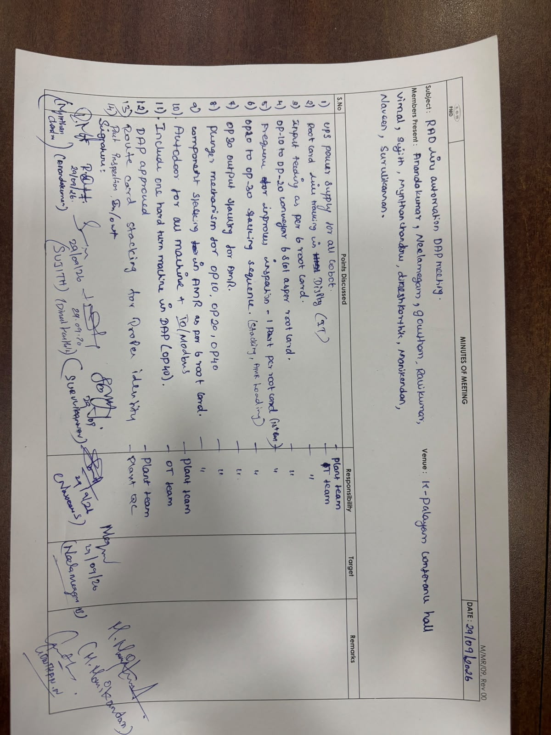
RAD Line SEP ( Plan VS actual)
LGB l Operations Technology

Slide 22
RAD LINE OCTOMBER PLANNED TASK
PROJECT SCHEDULE – BMW RAD ROBOTIC LINE PROJECT
Task ID | Task Description | Team | Planned |  | Actual |  | Status | % Complete | Remarks
 |  |  | Start | Finish | Start | Finish
MANUFACTURING & FABRICATION
BM-T32 | Procurement | Purchase | 1-Oct-26 | 2-Oct-26 |  |  | Open
BM-T33 | Manufacturing / Fabrication | Mechanical Team | 5-Oct-26 | 7-Oct-26 |  |  | Open
BM-T34 | Electrical Panel Design | Controls Team | 3-Oct-26 | 10-Oct-26 |  |  | Open
BM-T35 | PLC & HMI Development | Controls Team | 3-Oct-26 | 7-Oct-26 |  |  | Open
BM-T36 | Assembly | Project | 13-Oct-26 | 14-Oct-26 |  |  | Open
FAT, DISPATCH & SITE
BM-T37 | FAT | Project | 14-Oct-26 | 15-Oct-26 |  |  | Open
BM-T38 | Dispatch | Dispatch Team | 15-Oct-26 | 16-Oct-26 |  |  | Open
BM-T39 | Installation | Project | 17-Oct-26 | 15-Nov-26 |  |  | Open
LGB l Operations Technology

Slide 23
Thank You

